Slide 1
全球洋上における蒸発がサヘルの長期的な降水量変動に及ぼす影響
Influence of oceanic global evaporation upon long-term variation of large-scale Sahel rainfall
Mie university
Faculty of Bioresources
Department of climate and ecosystem
509M236 DIAWARA Alima
Supervisor: TACHIBANA Yoshihiro

Slide 2
Contents
Data
Introduction
Sahel rainfall
Previous presentation
Long-term and short-term variations
Sahel rainfall and others parameters
Conclusions

Slide 3
Data
GPCC Precipitation Data Set Monthly Mean Monitoring and Full Data,1951-04,resolution of 1.0×1.0.
NOAA Extended Reconstructed Sea Surface Temperature (SST)V3b,
monthly values for 1951-04, 2×2 of resolution.
NCEP/NCAR Reanalysis Monthly Means Latent and Sensible heat flux ,
monthly values for 1951-04,T62 Gaussian grid(1.875×1.91) of resolution.
NCEP/NCAR Reanalysis Monthly Means Horizontal wind, monthly values for
1951-04,T62 Gaussian grid(1.875×1.91) of resolution.
NCEP/NCAR ,Horizontal moisture heat flux and Net precipitation data
( Tachibana et al, 2008), monthly values for 1979-04,resolution of 2.5×2.5, 17 levels.
Mali precipitation data set, National Meteorology Centre of Mali for 1951-04

Slide 4
Introduction
Sahel is between
10N-20N
12W-45E
Sahel rainfall 1951-2004
1984
http://www.mapjourney.com/sahel/veg/veg_009_.htm

Slide 5
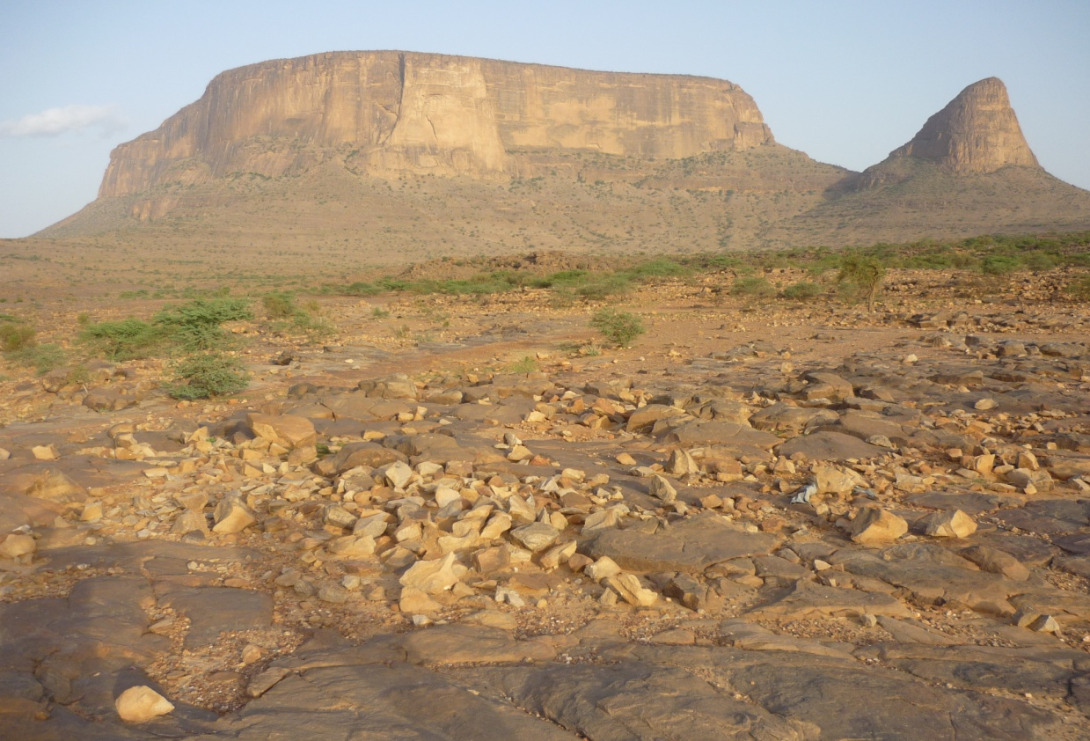
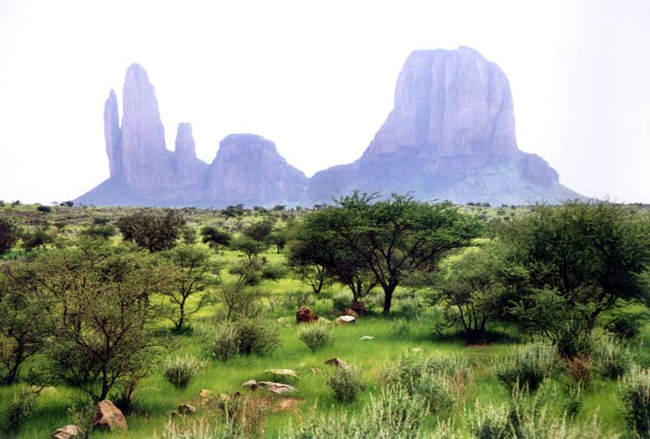
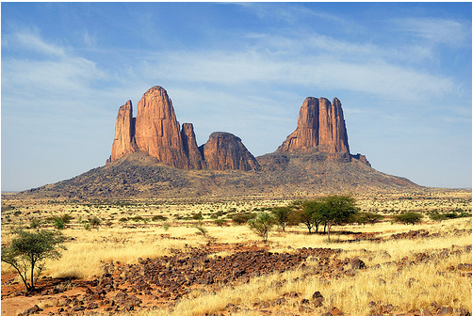
Introduction
August 2010-somewhere in Sahel region
Sahel wet period
Sahel dry period
Me
Program AMMA
Situation of Sahel in 2010
Less vegetation
Soil dry
Program AMMA

Slide 6
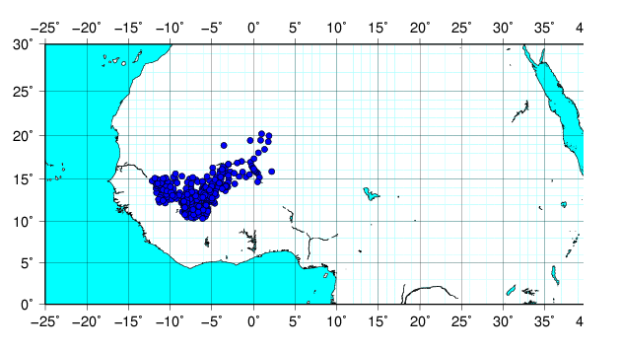
Sahel rainfall
392 stations for precipitation data
In red color , Sahel region zone taken for this study
In blue color the station repartition of precipitation station of
National Meteorology Centre of Mali.

Slide 7
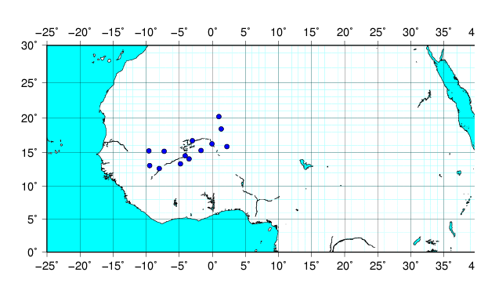
Sahel rainfall
Sahel limit selected
10N-20N
15W-35E
M
L
G
K
J
I
F
E
H
B
A
D
C
Bamako | A
Kita | B
San | C
Bankass | D
Mopti | E
Nara | F
Nioro | G
Hombori | H
Menaka | I
Gao | J
Tombouctou | K
Kidal | L
Tessalit | M

Slide 8
Sahel rainfall
Sahel | Average
1951 | 473.37
1952 | 565.59
1953 | 541.61
1954 | 516.59
1955 | 453.42
1956 | 494.78
1957 | 524.06
1958 | 516.02
1959 | 440.21
1960 | 415.51
1961 | 374.75
1962 | 457.62
1963 | 434.93
1964 | 459.26
1965 | 441.81
1966 | 403.73
1967 | 414.23
1968 | 375.52
1969 | 379.2
1970 | 366.03
1971 | 370.89
1972 | 343.03
1973 | 290.3
1974 | 339.02
1975 | 399.01
1976 | 374.61
1977 | 363.42
1978 | 417.24
1979 | 358.28
Times series of
Average (mm/year )
Annually precipitation
1980 | 405.41
1981 | 360.09
1982 | 281.72
1983 | 288.76
1984 | 245.67
1985 | 325.06
1986 | 341.08
1987 | 245.93
1988 | 397.21
1989 | 393.11
1990 | 278.16
1991 | 399.84
1992 | 289.3
1993 | 361.14
1994 | 468.36
1995 | 338.64
1996 | 357.49
1997 | 286.4818
1998 | 399.79
1999 | 460.71
2000 | 328.86
2001 | 385.33
2002 | 280.99
2003 | 426.19

Slide 9
Sahel rainfall
AVERAGE (mm/year)
Sahel | Average
1951 | 473.37
1952 | 565.59
1953 | 541.61
1954 | 516.59
1955 | 453.42
1956 | 494.78
1957 | 524.06
1958 | 516.02
1959 | 440.21
1960 | 415.51
1961 | 374.75
1962 | 457.62
1963 | 434.93
1964 | 459.26
1965 | 441.81
1966 | 403.73
1967 | 414.23
1968 | 375.52
1969 | 379.2
1970 | 366.03
1971 | 370.89
1972 | 343.03
1973 | 290.3
1974 | 339.02
1975 | 399.01
1976 | 374.61
1977 | 363.42
1978 | 417.24
1979 | 358.28
Times series of
Average (mm/year )
Annually precipitation
1980 | 405.41
1981 | 360.09
1982 | 281.72
1983 | 288.76
1984 | 245.67
1985 | 325.06
1986 | 341.08
1987 | 245.93
1988 | 397.21
1989 | 393.11
1990 | 278.16
1991 | 399.84
1992 | 289.3
1993 | 361.14
1994 | 468.36
1995 | 338.64
1996 | 357.49
1997 | 286.4818
1998 | 399.79
1999 | 460.71
2000 | 328.86
2001 | 385.33
2002 | 280.99
2003 | 426.19
Mali station data set
Cor=0.86
Time series
1984
GPCC
Time series

Slide 10
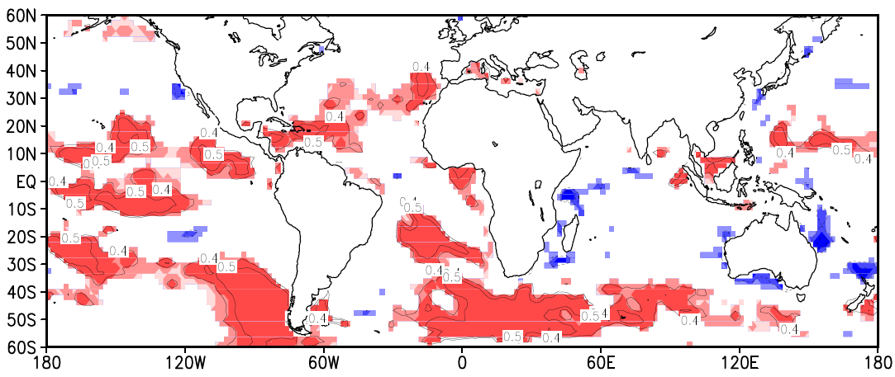
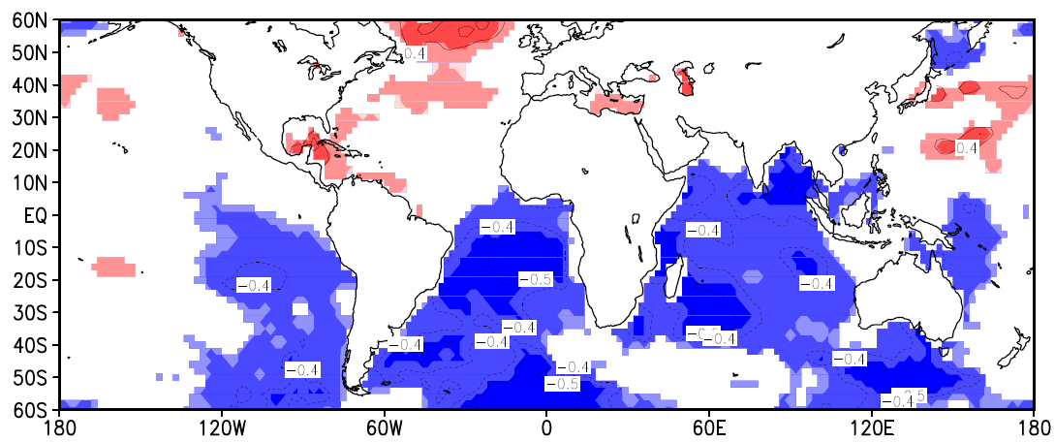
Previous presentation
SST (warmer – colder ) period horizontal wind vector
Correlation coefficient
Index | Global Latent-ocean (W/m²) | Global SST (c)
Sahel rainfall (mm) | 0.53 | -0.46

Slide 11
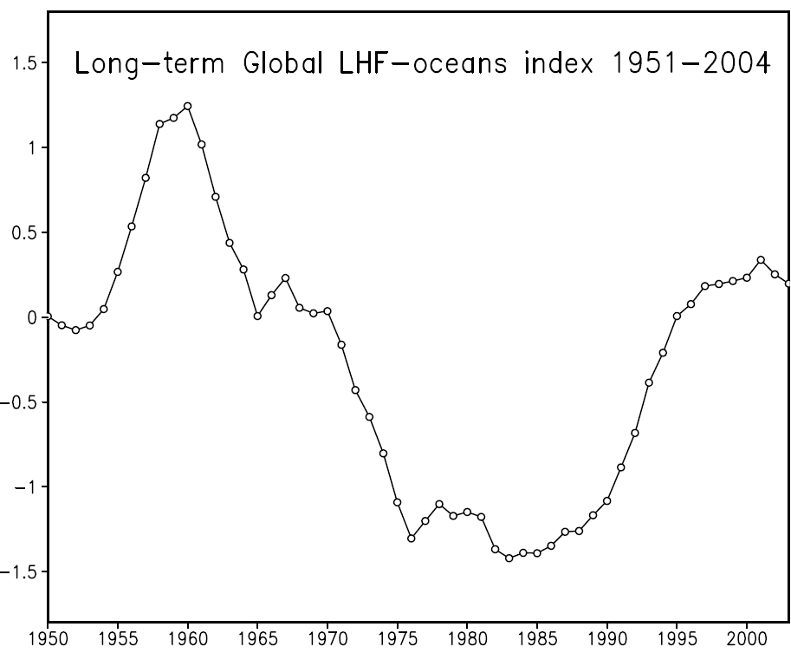
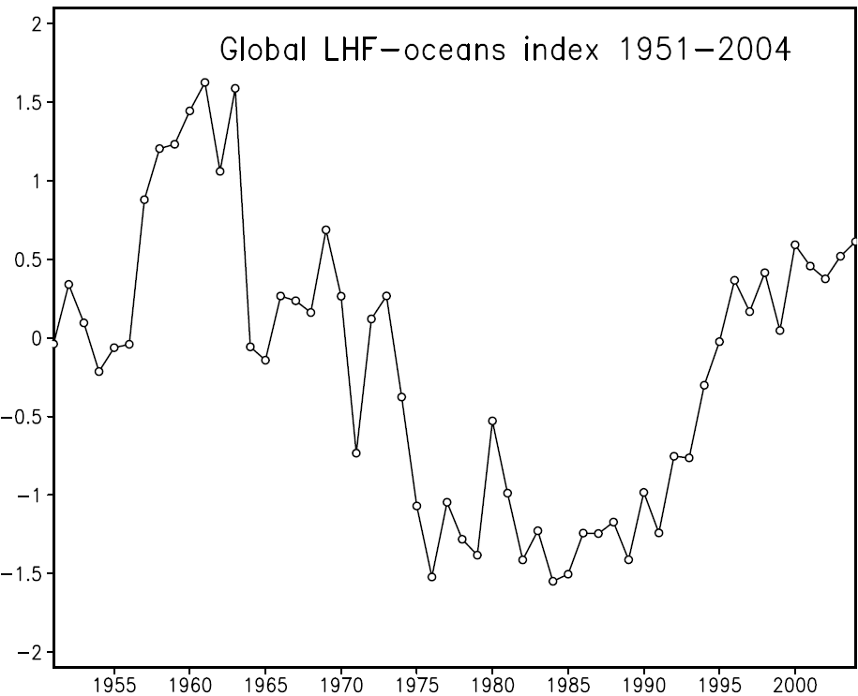
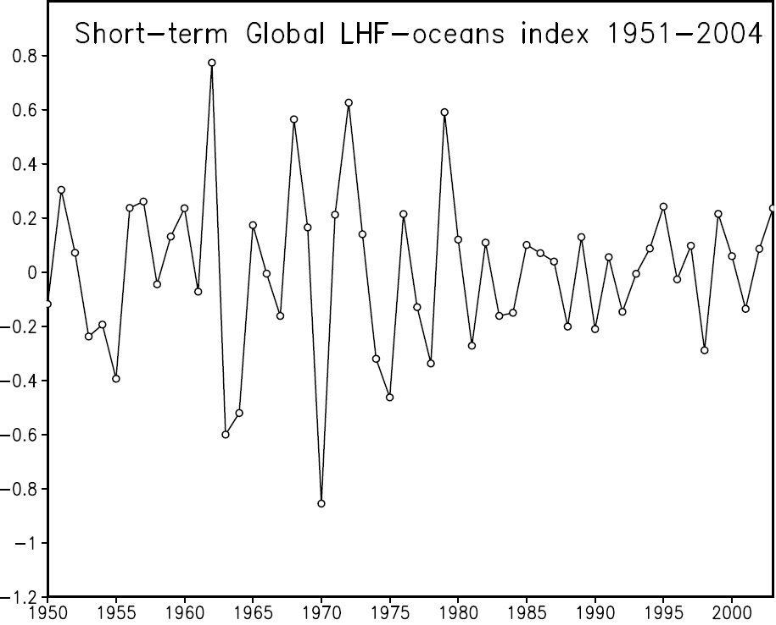
Long-term and Short-term variation
Long-term → ちょうき
Short-term → たんき
Normalized
Normalized
Time series
Time series

Slide 12
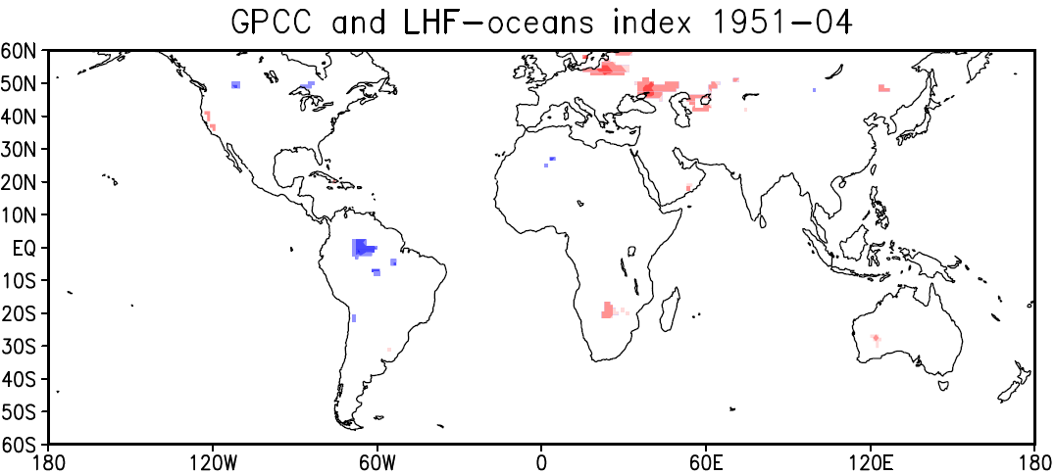
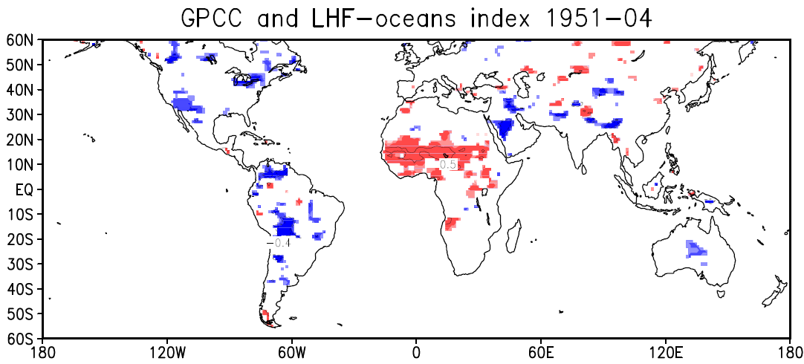
Long-term and Short-term variation
Short-term
Long-term

Slide 13
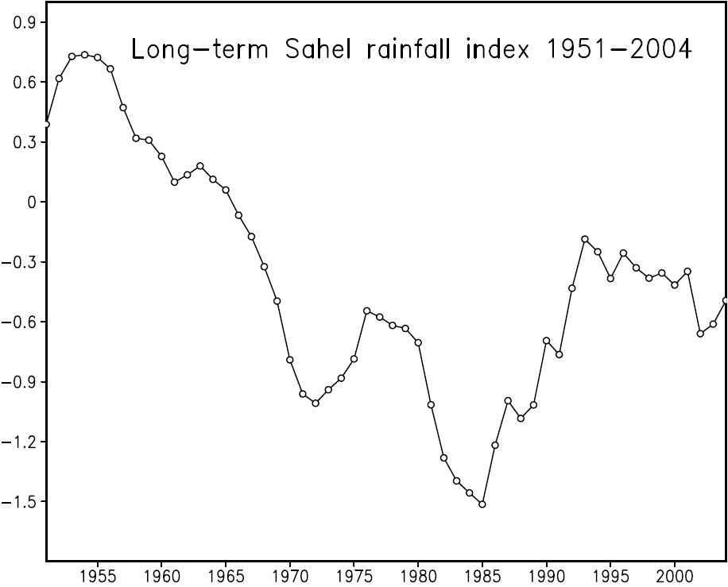
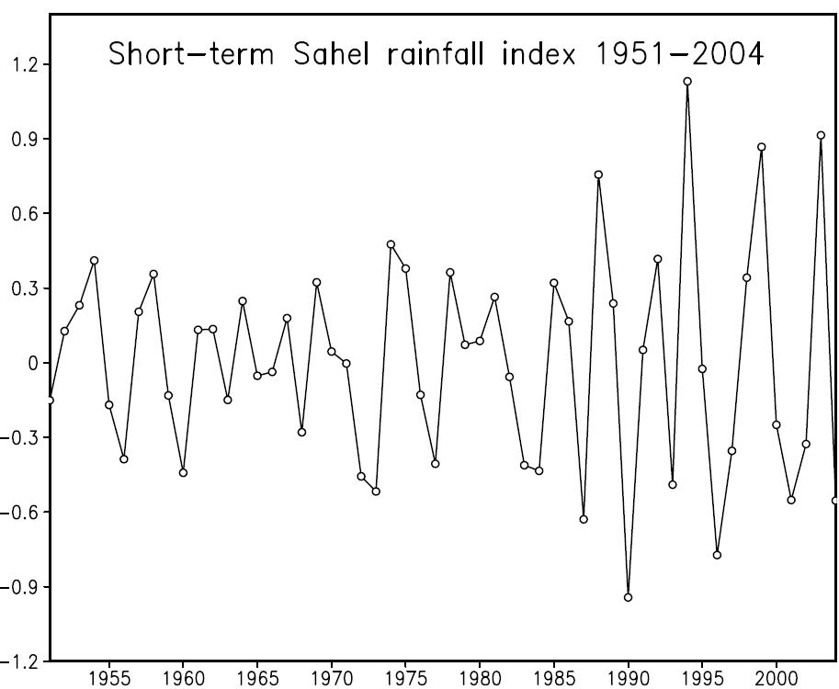
Long-term and Short-term variation
Long-term → ちょうき
Short-term → たんき
Normalized
Same method is done
Times series

Slide 14
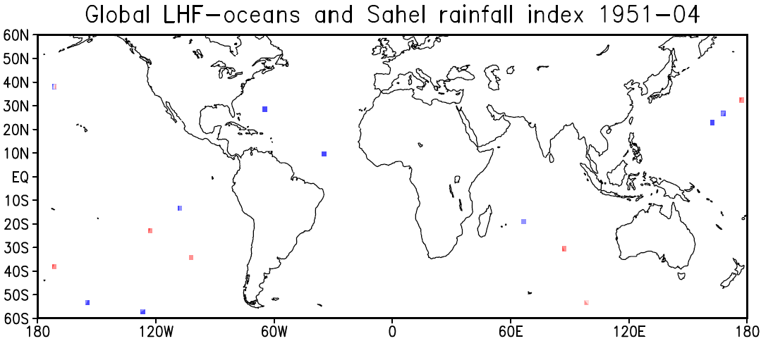
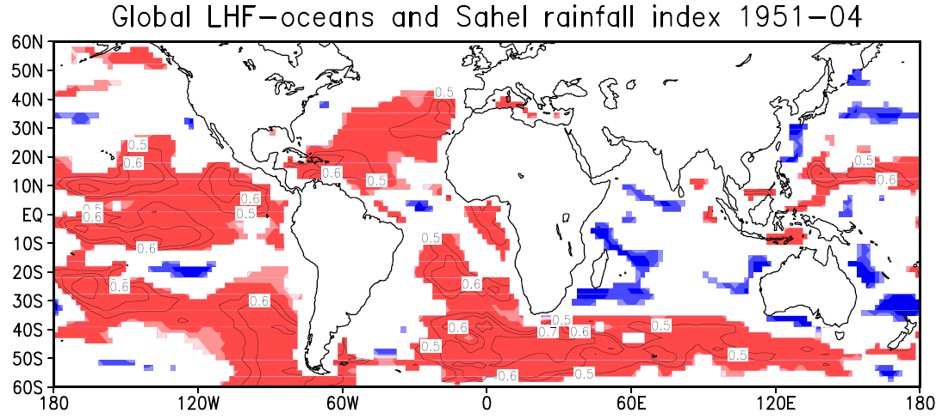
Long-term and Short-term variation
Short-term
Long-term

Slide 15
Long-term and Short-term variation
Short-term
Long-term
NO MATCH
Cor = 0.6
NO MATCH

Slide 16
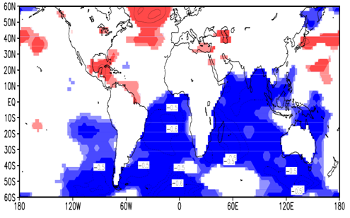
Long-term and Short-term variation
Short-term
Total
Long-term
NO MATCH
Cor = 0.6
NO MATCH
Long-term

Slide 17
Long-term and Short-term variation
Correlation of Index
Total
Correlation | SST | Sahel | LHF-oceans
SST | 1 | -0.46 | -0.11
Sahel | -0.46 | 1 | 0.53
Long-term
Correlation | SST | Sahel | LHF-oceans
SST | 1 | -0.42 | -0.18
Sahel | -0.42 | 1 | 0.73
Short-term
Correlation | SST | Sahel | LHF-oceans
SST | 1 | 0.24 | 0.04
Sahel | 0.24 | 1 | -0.08

Slide 18
Sahel rainfall and others parameters
Divergence moisture flux
Net precipitation
Sahel rainfall
Net precipitable = rainfall - evaporation
Moisture flux divergence and Net precipitable
Calculate by Tachibana et al 2008

Slide 19
Sahel rainfall and others parameters
P is precipitation (Sahel )
E is evaporation Sahel)
PE is net precipitation
PE= P-E
Net precipitation
Tachibana et al (2008)
E = P-PE
When Sahel rainfall decreased
(increased) the evaporation
also decreased(increased)
The difference between
rainfall and evaporation shows
that from 1988 to 1998 the
evaporation is higher than
the rainfall.
THAT WHY THE SAHEL REGION STILL DRY!!!

Slide 20
Sahel rainfall and others parameters
It is very difficult to estimate the quantity of evaporation
itself but we compare the trend of evaporation with the temperature. Because when the temperature increase the evaporation also increase. So it is possible to know if the estimation of evaporation is correct.

Slide 21
Results
The results observed:
The influence of global latent heat flux from oceans upon Sahel rainfall
has been successfully demonstrated
The correlation of long-term latent heat flux from oceans with Sahel rainfall showed a high correlation on East Pacific ocean, Atlantic ocean and Indian ocean and influences the Sahel rainfall through its long-term variation.
The Sahel rainfall has recently increasing but ……..
The temperature in Sahel region is increasing too and leads an increasing of evaporation.
When the net precipitation is still almost around zero, Sahel rainfall was negative, when the net precipitation is negative the Sahel rainfall was starting a increasing trend.
THAT WHY THE SAHEL REGION IS STILL DRY!!!!!!!!
The dryness of Sahel region is not directly related to the precipitation.
It will be interesting to study the local dynamic meteorology process of Sahel region.

Slide 22
References:
-Folland, C. K, T. N. Palmer, D. E. Parker, Sahel rainfall and worldwide sea temperatures, 1901-85. Nature, 1986, Vol.320, p.602-607, doi: 10.1038/320602a0.
-Palmer, T.N, Influence of the Atlantic, Pacific and Indian Oceans on Sahel rainfall. Nature 322, 251 - 253 (17 July 1986); doi: 10.1038/322251a0.
Tachibana, Y., K. Oshima and M. Ogi, Seasonal and annually variations of Amur River discharge and their relationships to large-scale atmospheric patterns and moisture fluxes, Journal of Geophysical Research, 113, D16102, 2008.
- Munemoto, M. and Y. Tachibana, The recent trend of increasing precipitation in Sahel and the associated inter-hemispheric dipole of global SST, International, Journal of Climatology,2010 (Submitted).
(Katz RW, Glantz MH. 1986. Anatomy of a rainfall index. Monthly Weather Review 114: 764–771).
Kistler, R., E. Kalnay, W. Collins, S. Saha, G. White, J. Woollen, M. Chelliah, W. Ebisuzaki, M. Kanamitsu, V. Kousky, H. van den Dool, R. Jenne, M. Fiorino, 2001: The NCEP-NCAR 50-Year Reanalysis: Monthly Means CD-ROM and Documentation. Bull. Amer. Meteor. Soc., 82, 247-268. -Rowell, D. P., 2003: The Impact of Mediterranean SSTs on the Sahelian Rainfall Season, 16, 849-8610.
-Palmer, T. N., Influence of the Atlantic, Pacific and Indian Oceans on Sahel rainfall, Nature, 322, 251–253, 1986.
-Giannini A, Saravanan R, Chang P (2003) Oceanic forcing of Sahel rainfall on annually to interdecadal time scales. Science 302:1027–1030. doi:10.1126/science.1089357 (Published online 9 October 2003).
-Wolter, K., 1989: Modes of tropical circulation, Southern Oscillation, and Sahel rainfall anomalies. J. Climate, 2, 149-172
-Holton, M. James; An introduction to dynamic meteorology, fourth edition. Elsevier,
Vol 4, p.118-120.
-Wallace, M.John., Peter V.HOBBS; Atmosphere science, an introductory survey,
Academic press,27-40.
-Oshima, K., and K. Yamazaki, 2006: Difference in seasonal variation of net precipitation between the Arctic and Antarctic regions. Geophys. Res. Lett., 33, L18501, doi:10.1029/2006GL027389.

Slide 23
THANKS FOR YOUR KIND ATTENTION

