Slide 1




Abnormal winter weather in Japan during 2012 controlled by large-scale atmospheric and small-scale oceanic phenomena
2014/07/29 AOGS 11th Annual Meeting in Sapporo
We submitted the manuscript about this study to Monthly Weather Review.
Yuta Ando¹, Masayo Ogi², Yoshihiro Tachibana¹
¹Climate and Ecosystems Dynamics Division, Mie Univ.,
²Centre for Earth Observation Science, Univ. of Manitoba
The speaker took this picture on 11 December, 2012 over the ocean near Japan.

Slide 2
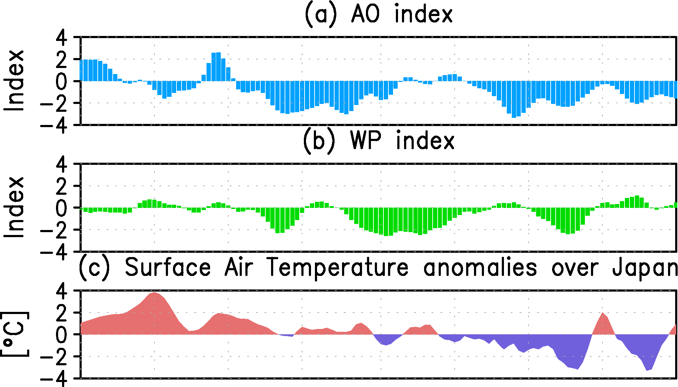
Introduction
October to December 2012
Negative Arctic Oscillation (AO)
＆Western Pacific（WP）pattern persisted
Negative AO:
Influence occurrence of cold surges over East Asia
Negative WP:
Lead to cold temperature over East Asia
In 2012
The periods of 2 weeks continuously negative AO&WP
Period 1 (3 October to 16 October):
Temperatures over Japan were not cold
Period 2 (1 December to 14 December):
Temperatures over Japan were so cold
Period 1
Period 2
Other factor
overwhelmed or intensified the cooling effect
of negative AO&WP
Objective
To find other factor influenced the Temperatures over Japan in 2012

Slide 3
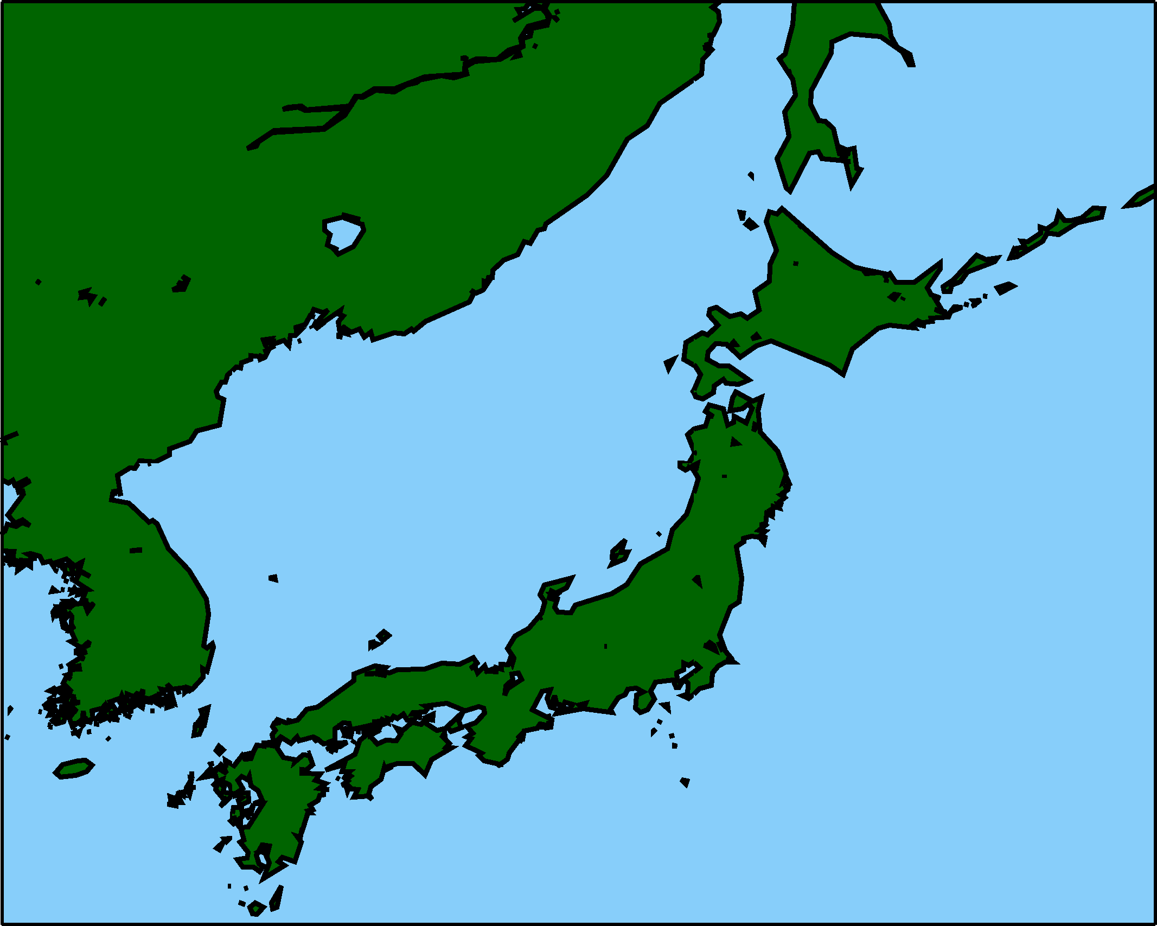
Conclusion
October to
December 2012
Large-scale atmospheric phenomena
Negative AO&WP persisted
→tended to cool Japan
Period 1
(Early in October)
Period 2
(Early in December)
Cold air
Cold air
Warm SST
Cold SST
Warm Temperatures
Cold
Temperatures
Small-scale oceanic phenomena
Warm SST
→Overwhelmed effect of negative AO&WP
→Temperatures over Japan were warm
Cold SST
→Intensified effect of negative AO&WP
→Temperatures over Japan were cold

Slide 4
Data and Methods
Data
•Daily NCEP/NCAR-1 reanalysis
•Daily Sea Surface Temperature (SST):
NOAA 1/4°OISST V2
•Daily Surface Air Temperature in Japan:
Automated Meteorological Data Acquisition System (AMeDAS)
•The analysis period:
1982 - 2012
•”Interannual index”:
normalized by standard deviation during
Period 1 or Period 2 from 1982 to 2012
•Removed trends of increasing temperature

Slide 5
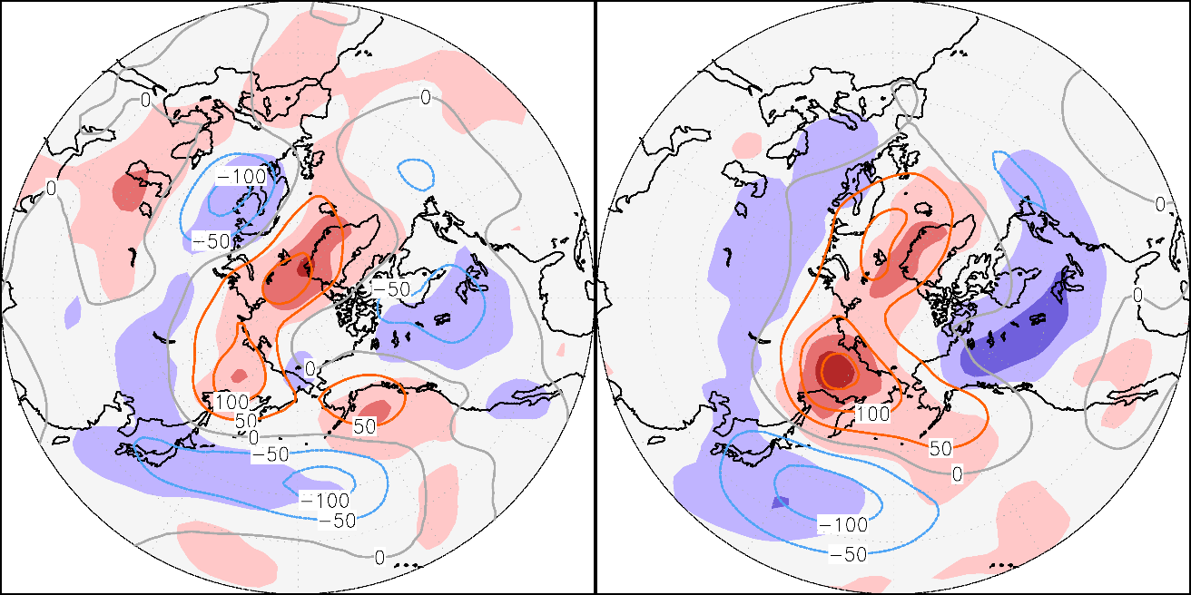
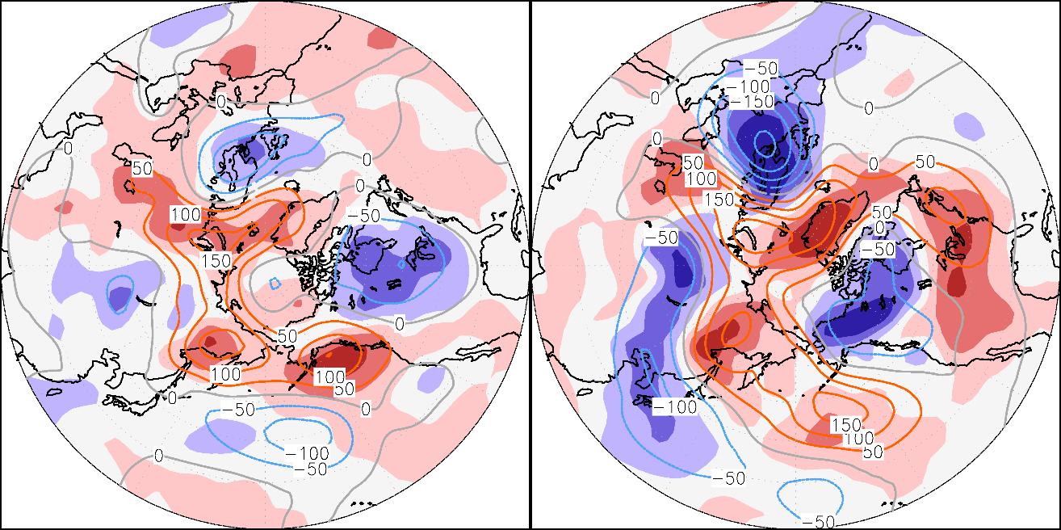
Large-scale Atmospheric Control
- Compared with Estimated and Observed Z500&T850 (2012)
Estimated by AO&WP
Estimated Geopotential height anomalies at 500 hPa (Z500) & Air temperature anomalies at 850 hPa (T850) by multiple linear regression in AO&WP interannual indices
Period 1
Period 2
90°W
Observed
Estimated & Observed Z500&T850 were similar
Period 1
Period 2
90°W
Contours: Z500 anomalies
Color shading: T850 anomalies

Slide 6
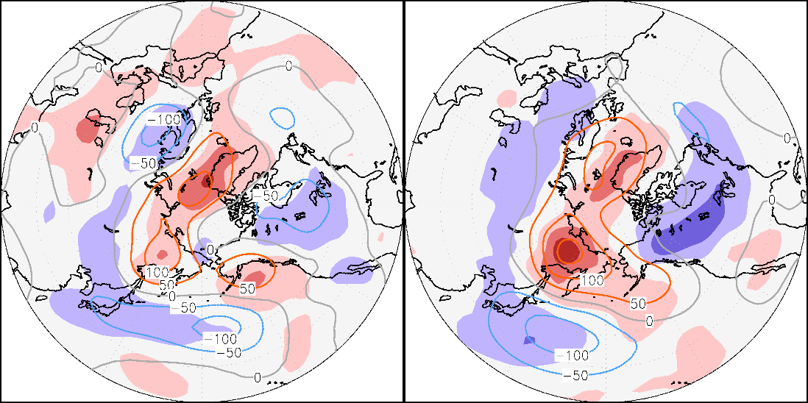

Large-scale Atmospheric Control
- Compared with Estimated and Observed Z500&T850 (2012)
Estimated by AO&WP
Estimated Geopotential height anomalies at 500 hPa (Z500) & Air temperature anomalies at 850 hPa (T850) by multiple linear regression in AO&WP interannual indices
Period 1
Period 2
90°W
Observed
Estimated & Observed Z500&T850 were similar
Period 1
Period 2
90°W
Contours: Z500 anomalies
Color shading: T850 anomalies
Over Japan
Period 1: Observed T850 was positive, despite Estimated was negative
Period 2: Observed T850 was less than Estimated

Slide 7
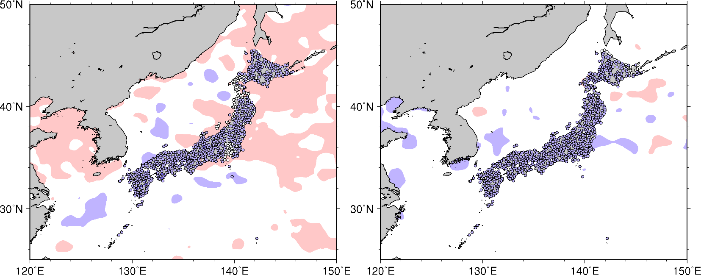
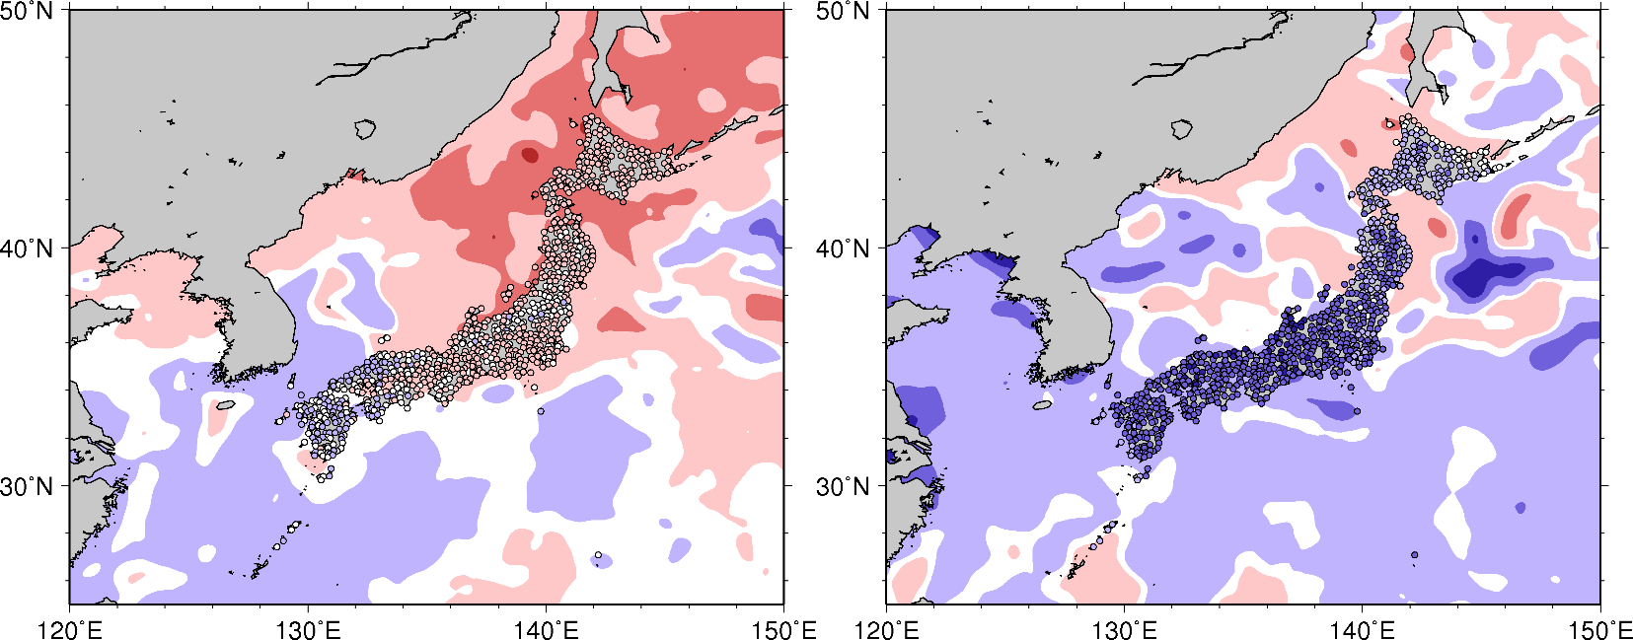

Large-scale Atmospheric Control
- Compared with Estimated and Observed SST&Air temperature (2012)
Estimated by AO&WP
Estimated SST&Air temperature by multiple linear regression in AO&WP interannual indices
Period 1
Period 2
Color shading: SST anomalies
Color circles: Air temperature anomaly at AMeDAS weather station
Observed
Period 1
Period 2

Slide 8
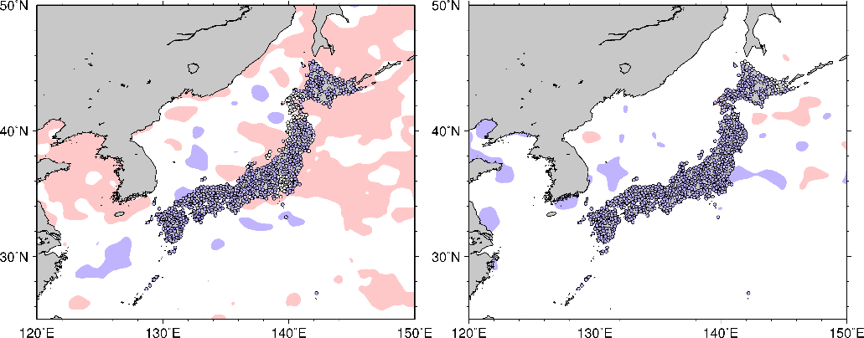
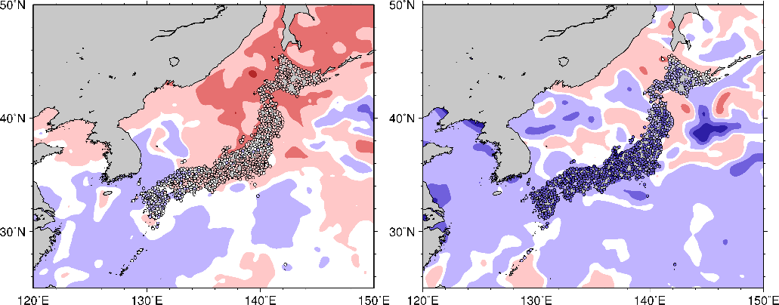

Large-scale Atmospheric Control
- Compared with Estimated and Observed SST&Air temperature (2012)
Estimated by AO&WP
Estimated SST&Air temperature by multiple linear regression in AO&WP interannual indices
Period 1
Period 2
Color shading: SST anomalies
Color circles: Air temperature anomaly at AMeDAS weather station
Observed
Period 1
Period 2
Period 1: Observed Air temperatures were positive
, despite Estimated were negative
Period 2: Observed Air temperatures were less than Estimated
Other factor decreased or increased
the cooling effect of negative AO&WP

Slide 9
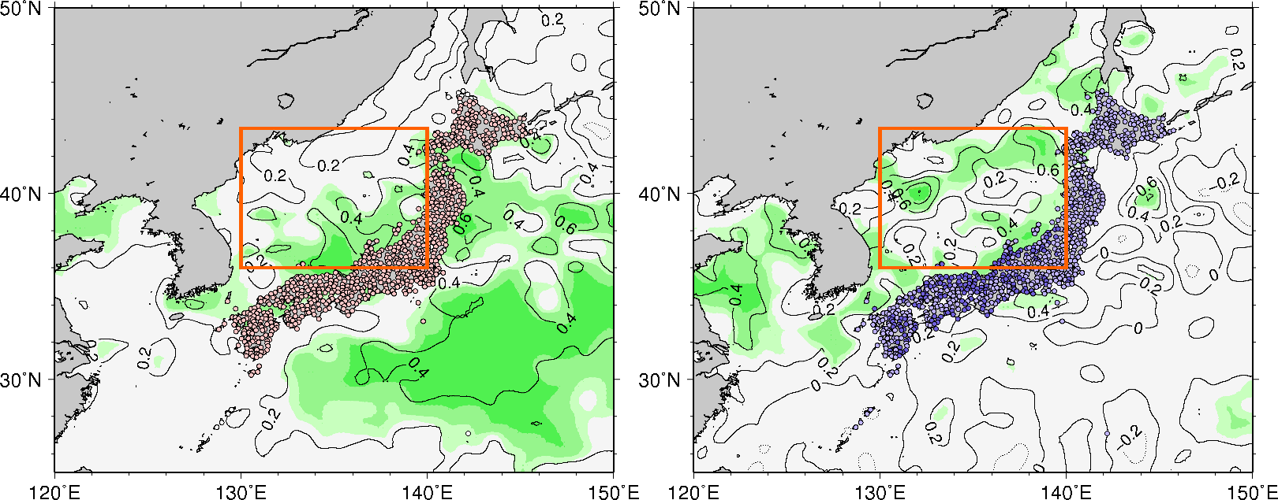
Small-scale Oceanic Control
- Compared with Estimated and Residual Air temperature&SST (2012)
Ocean: Regression coefficients by Air temperature
Land: Estimated by SST
Regression SST coefficients by a linear regression in Air temperature over Japan interannual index
Period 1
The Sea of Japan
Period 2
Estimated Air temperatures by a linear regression in SST over the Sea of Japan interannual index
Contours (Ocean) : Regression coefficients, Color shading (Ocean): Significant levels
Color shading (Land): Air temperature anomalies
•SSTs over the Sea of Japan were positively correlated with Air temperature
•The Sea of Japan is located climatologically upstream of Japan during winter monsoon season
•SST over the Sea of Japan affect Air temperature
Period 1: Estimated were positive
Period 2: Estimated were negative
←Observed SST changed from positive to negative

Slide 10
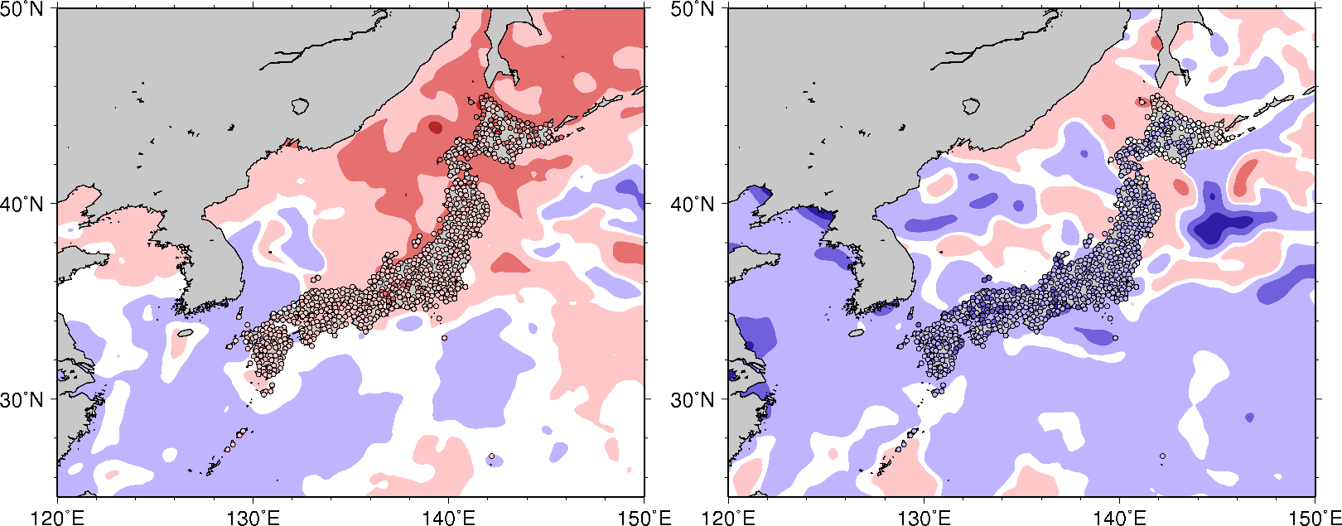
Small-scale Oceanic Control
- Compared with Estimated and Residual Air temperature&SST (2012)
Ocean: Regression coefficients by Air temperature
Land: Estimated by SST
Regression SST coefficients by a linear regression in Air temperature over Japan interannual index
Period 1
The Sea of Japan
Period 2
Estimated Air temperatures by a linear regression in SST over the Sea of Japan interannual index
Contours (Ocean) : Regression coefficients, Color shading (Ocean): Significant levels
Color shading (Land): Air temperature anomalies
Ocean: Observed
Land: Residual (Observed - Estimated by AO&WP)
Period 1
Period 2
Estimated
& Residual
Air temperatures were similar
Color shading: SST anomalies, Color circles: temperature anomaly at AMeDAS weather station

Slide 11

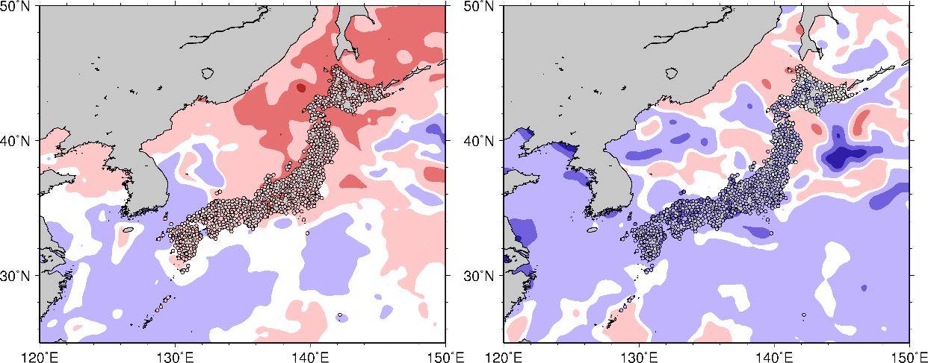

Small-scale Oceanic Control
- Compared with Estimated and Residual Air temperature&SST (2012)
Ocean: Regression coefficients by Air temperature
Land: Estimated by SST
Regression SST coefficients by a linear regression in Air temperature over Japan interannual index
Period 1
The Sea of Japan
Period 2
Estimated Air temperatures by a linear regression in SST over the Sea of Japan interannual index
Contours (Ocean) : Regression coefficients, Color shading (Ocean): Significant levels
Color shading (Land): Air temperature anomalies
Ocean: Observed
Land: Residual (Observed - Estimated by AO&WP)
Estimated
& Residual
Air temperatures were similar
Period 1
Period 2
Color shading: SST anomalies, Color circles: temperature anomaly at AMeDAS weather station
SST controlled Air temperatures
Positive (Negative) Residual Air temperatures were surrounded by positive (negative) Observed SST

Slide 12
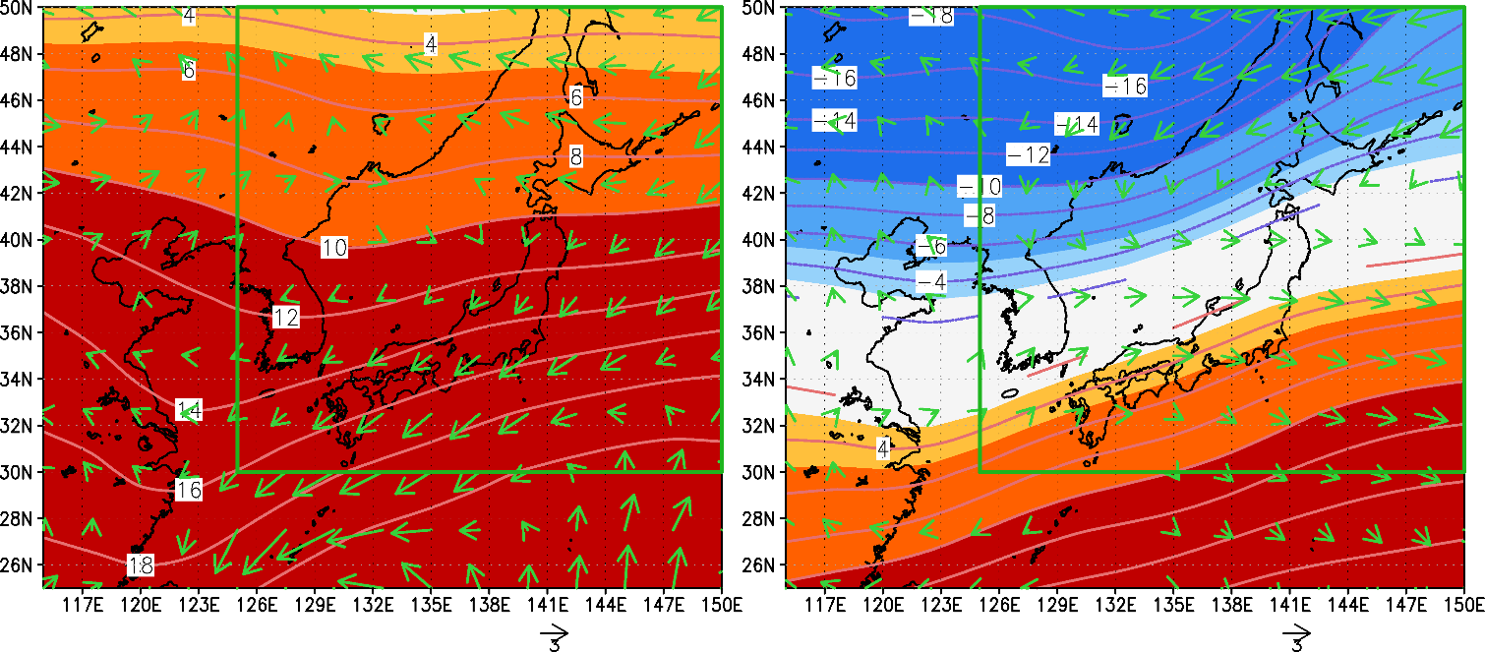
Discussion
- Horizontal anomalous temperature advection (2012)
Observed Va925&Tc925
subscript
“c”: climate value
“a”: anomaly in 2012
Period 1
Period 2
Temperature advection only by anomalous wind at 925 hPa, generated by atmospheric circulation
Contour&Color shading: T925 climate values
Vector: UV925 anomalies
Green box: areal average over Japan
Areal average over Japan
Anomalous atmospheric circulation
cooled Japan
Warm advection
Cold advection

Slide 13
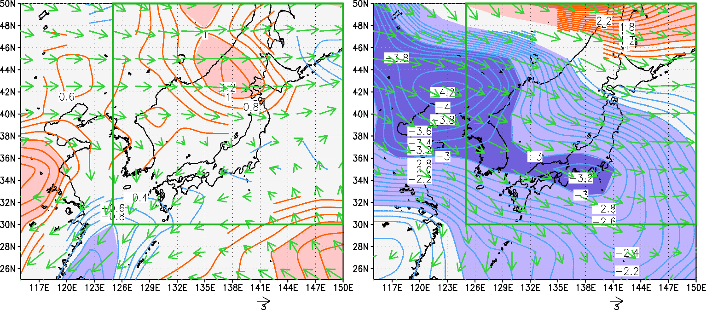
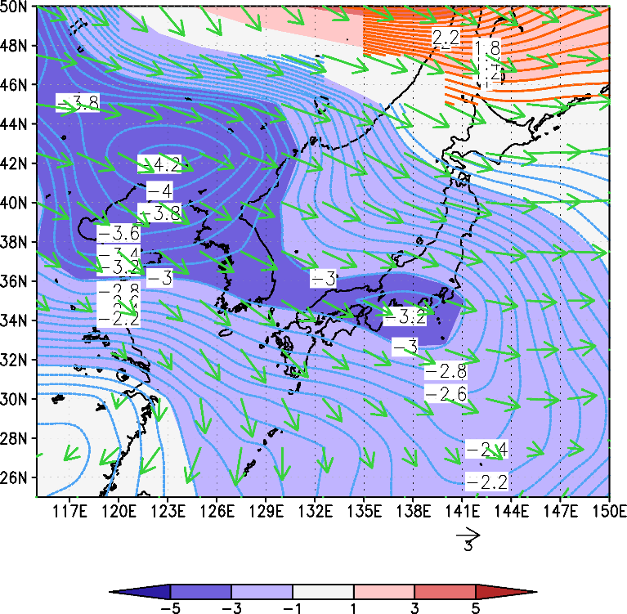
Discussion
- Horizontal anomalous temperature advection (2012)
Observed Vc925&Ta925
subscript
“c”: climate value
“a”: anomaly in 2012
Period 1
Period 2
Temperature advection only by anomalous air temperature at 925 hPa, related to SST
Contour&Color shading: T925 anomalies
Vector: UV925 climate values
Green box: areal average over Japan
Areal average over Japan
Anomalous SST decreased or increased
the cooling effect of negative AO&WP
Warm advection
Cold advection

Slide 14
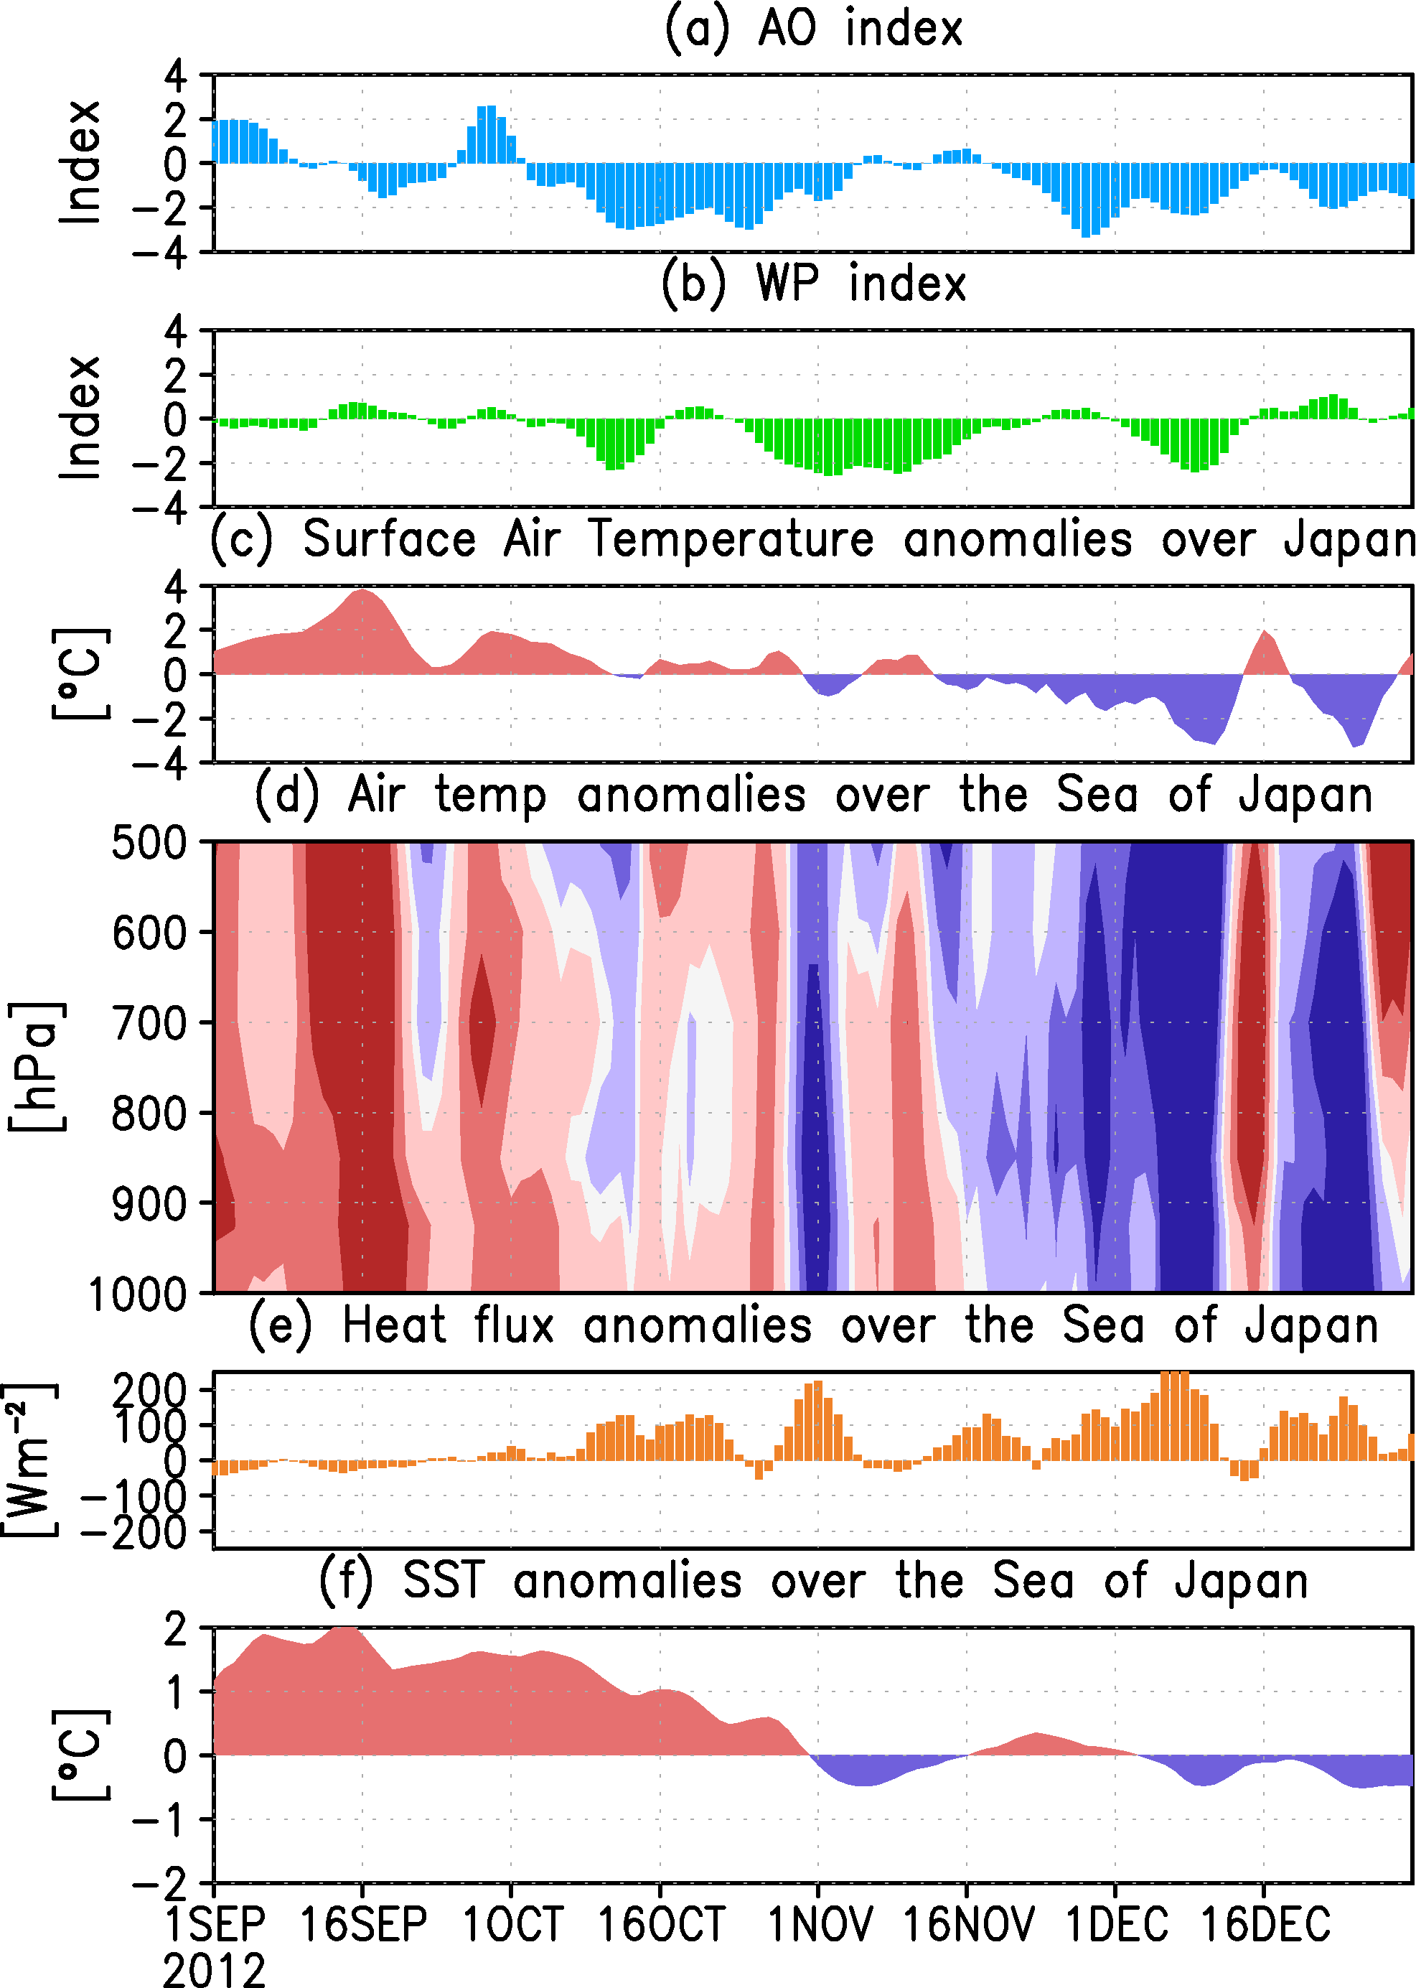
Discussion
- Relationship SST over the Sea of Japan and Air temperatures over Japan
Period 1
Period 2
•SST was independent of AO&WP
←SST were not correlated with AO&WP
•No other atmospheric circulations affected Japan
←investigated indices of atmospheric
circulations that influence temperatures
←The values of indices were close to 0
•El Niño-Southern Oscillation was neutral
→SST in the Sea of Japan mainly accounted
for Air temperatures over Japan
•Cold air was distributed from upper to lower
•Anomalous positive heat fluxes
result to reach cold air toward surface
Period 1
Temperatures were not cold
←Warm SST blocked upper level cold air
Period 2
Temperatures were cold
←Cold SST intensified the cooling effect
→The effect of negative AO&WP
can be modulated by SST

Slide 15
Conclusion
Ando et al., Abnormal winter weather in Japan during 2012 was controlled by large-scale atmospheric and small-scale oceanic phenomena, 2014, Monthly Weather Review, in review.
October to
December 2012
Large-scale atmospheric phenomena
Negative AO&WP persisted
→tended to cool Japan
Period 1
(Early in October)
Period 2
(Early in December)
Cold air
Cold air
Warm SST
Cold SST
Warm Temperatures
Cold
Temperatures
Small-scale oceanic phenomena
Warm SST
→Overwhelmed effect of negative AO&WP
→Temperatures over Japan were warm
Cold SST
→Intensified effect of negative AO&WP
→Temperatures over Japan were cold

